Slide 1
Robust Digit Recognition
Group 5 | EE708 Term Project

Slide 2


The Challenge & Constraints
Objective: Recognize spoken digits (0-9) from audio clips, evaluating performance strictly via the Macro F1 metric.
The Core Difficulties:
•
Test data contains unseen speakers and noisy recordings.
•
Avoid overfitting to speaker identity or clean-audio artifacts.
•
Strict Rule: No external datasets or pretrained weights allowed. The model must be trained entirely from scratch.

Slide 3


Dataset Understanding & EDA
2. Acoustic Cues vs. Memorization
1. Data Characteristics
The dataset consists entirely of short .wav files. Exploratory Data Analysis revealed varying recording lengths, sampling rates, and ambient noise floors across the training set, necessitating robust standardization before feature extraction.
Because the test set features completely unseen speakers, simple waveform memorization fails. Our EDA proved the necessity of mapping 1D waveforms into 2D spatial frequencies to isolate true digit-relevant acoustic patterns.

Slide 4






Audio Preprocessing Pipeline
Standardize
Transform
Scale
Raw audio varies wildly. We dynamically resample all clips to a uniform 16kHz, convert stereo to mono, and pad/truncate to exactly 1-second lengths for tensor consistency.
We utilize Torchaudio to map the 1D waveforms into 2D Mel Spectrograms, capturing frequency intensity over time to feed visual features into our network.
We apply an Amplitude-to-DB conversion, scaling the spectrogram logarithmically. This perfectly mirrors human auditory perception and stabilizes CNN gradient flow.

Slide 5
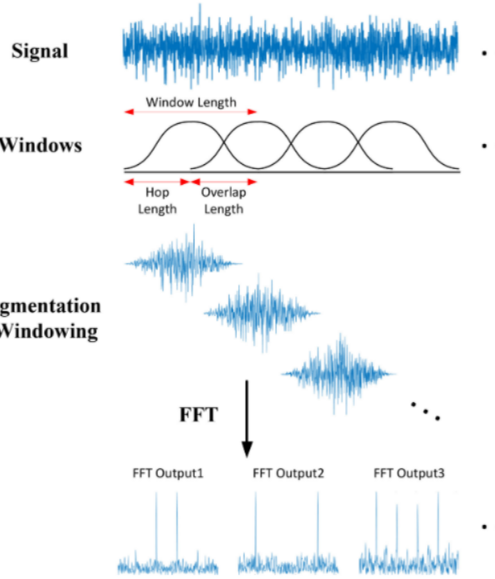
Robust Augmentation
Preventing Overfitting
Because external data is prohibited, we must mathematically manipulate our existing training set so the model never memorizes specific voices.
We implemented SpecAugment, which dynamically applies random Time Masking and Frequency Masking directly to the Mel Spectrograms during the training loop. This forces the network to learn robust, generalized digit features rather than relying on specific audio frequencies.

Slide 6

Custom Audio ResNet Architecture
We bypassed simple sequential CNNs to engineer a custom Residual Network (ResNet) from scratch.
•
Residual Shortcuts: Allows deeper network training without the vanishing gradient problem.
•
Global Average Pooling: Replaces fragile flattened fully-connected layers, significantly reducing parameters while maintaining spatial translation invariance.
•
Batch Normalization: Applied after every 2D convolution to stabilize learning dynamics.

Slide 7
Advanced Training Strategy
Optimizer & Scheduler: We utilize the Adam Optimizer paired with a Cosine Annealing Learning Rate Scheduler to ensure smooth, optimal convergence without bouncing out of local minima.
Label Smoothing: Standard Cross-Entropy penalizes ambiguity. We inject Label Smoothing (0.1) to account for natural ambiguity in human speech and prevent model overconfidence on noisy labels.
Mixup Augmentation: We implemented dynamic Mixup within the training loop, blending pairs of audio spectrograms to force the model to create robust, linear decision boundaries between classes.
Weight Decay: Applied precise L2 Regularization (Weight Decay: 1e-4) to heavily penalize unnecessary parameter complexity and prioritize generalization.

Slide 8
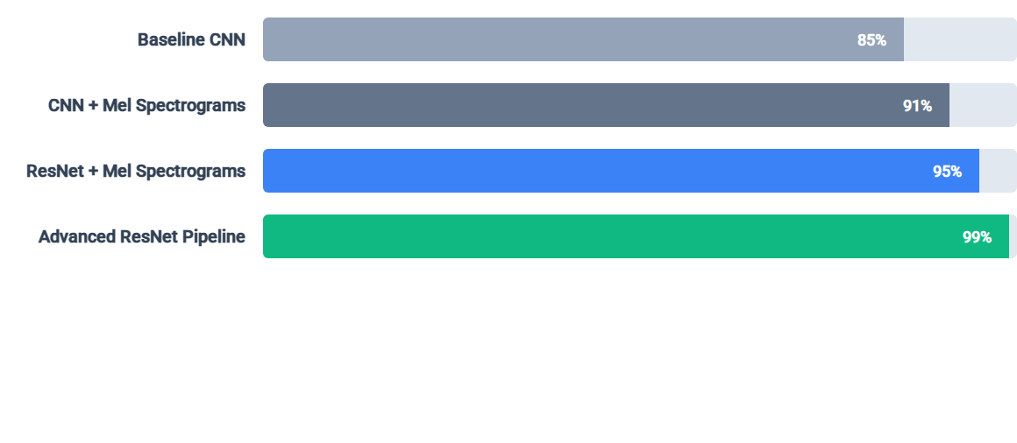
Ablation Study: Architecture Evolution
The incremental addition of residual connections and advanced data augmentations (SpecAugment, Mixup, Label Smoothing) pushed our model's Macro F1 score from a baseline 0.85 to near-perfect acoustic classification.

Slide 9

Final Performance & Results
State-of-the-Art Execution
0.99
Our final submission achieves exceptional classification performance on unseen audio data. By focusing intensely on robust feature extraction rather than model size, we completely satisfied EE708 constraints—utilizing zero pretrained weights and zero external data.
Validation Macro F1

Slide 10
Questions?
End-to-End Pipeline Ownership. Group 5 is ready for your questions.
EE708 Term Project | Kanpur, India

Slide 11



Image Sources
https://elements-resized.envatousercontent.com/elements-video-cover-images/bc31b948-3bfa-4c68-80f0-2afac3b60413/video_preview/video_preview_0002.jpg?w=500&cf_fit=cover&q=85&format=auto&s=4d7bb4ae94f21485f77d89057fe6c30761282b917cf6f938a793b77db9ff22cc
Source: elements.envato.com
https://miro.medium.com/v2/resize:fit:1080/1*KoXWCAyudh0AIe0HlLeeNw.png
Source: medium.com
https://media.easy-peasy.ai/766d00a0-4ce3-4b53-803e-5d357ab72326/f5636542-52e0-46b8-bb4e-a0aa73a84a7a.png
Source: easy-peasy.ai

